Slide 1
Gestures

Slide 2
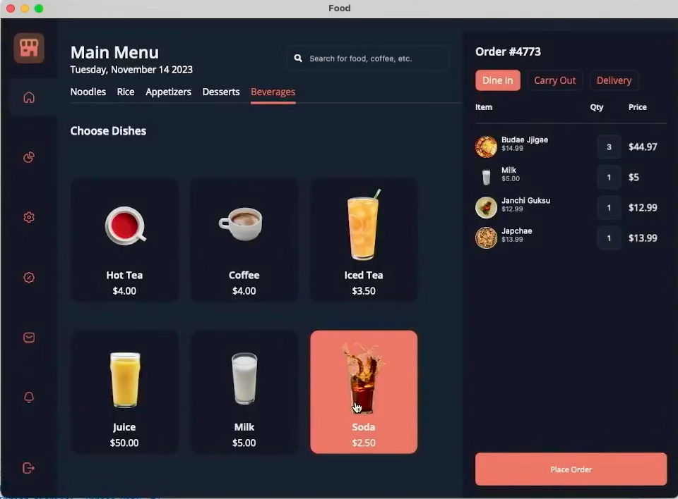
Creating UI Gestures
Drag Gesture Example
Tap Gesture
Pan Gesture
Pinch Gesture
Swipe Gesture
Drag Gesture
Pointer Gesture
Desktop Only
YouTube: @dotnet

Slide 3
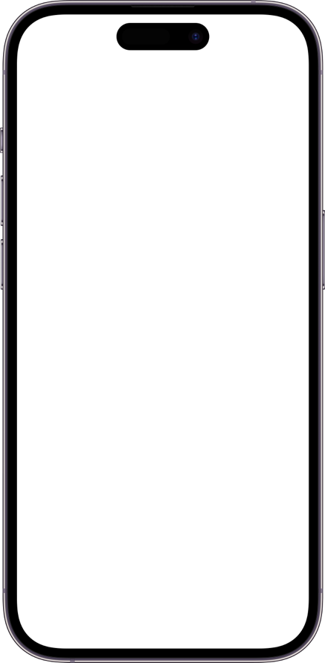
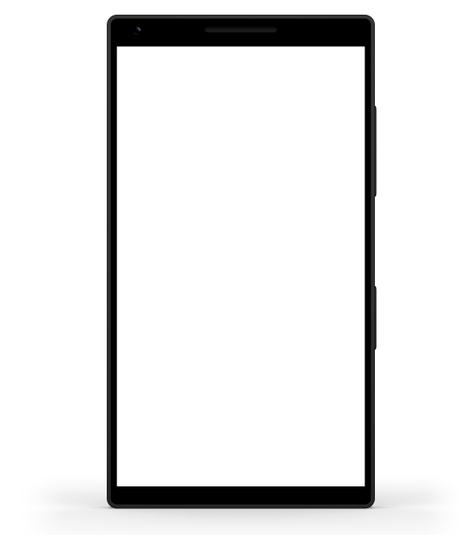
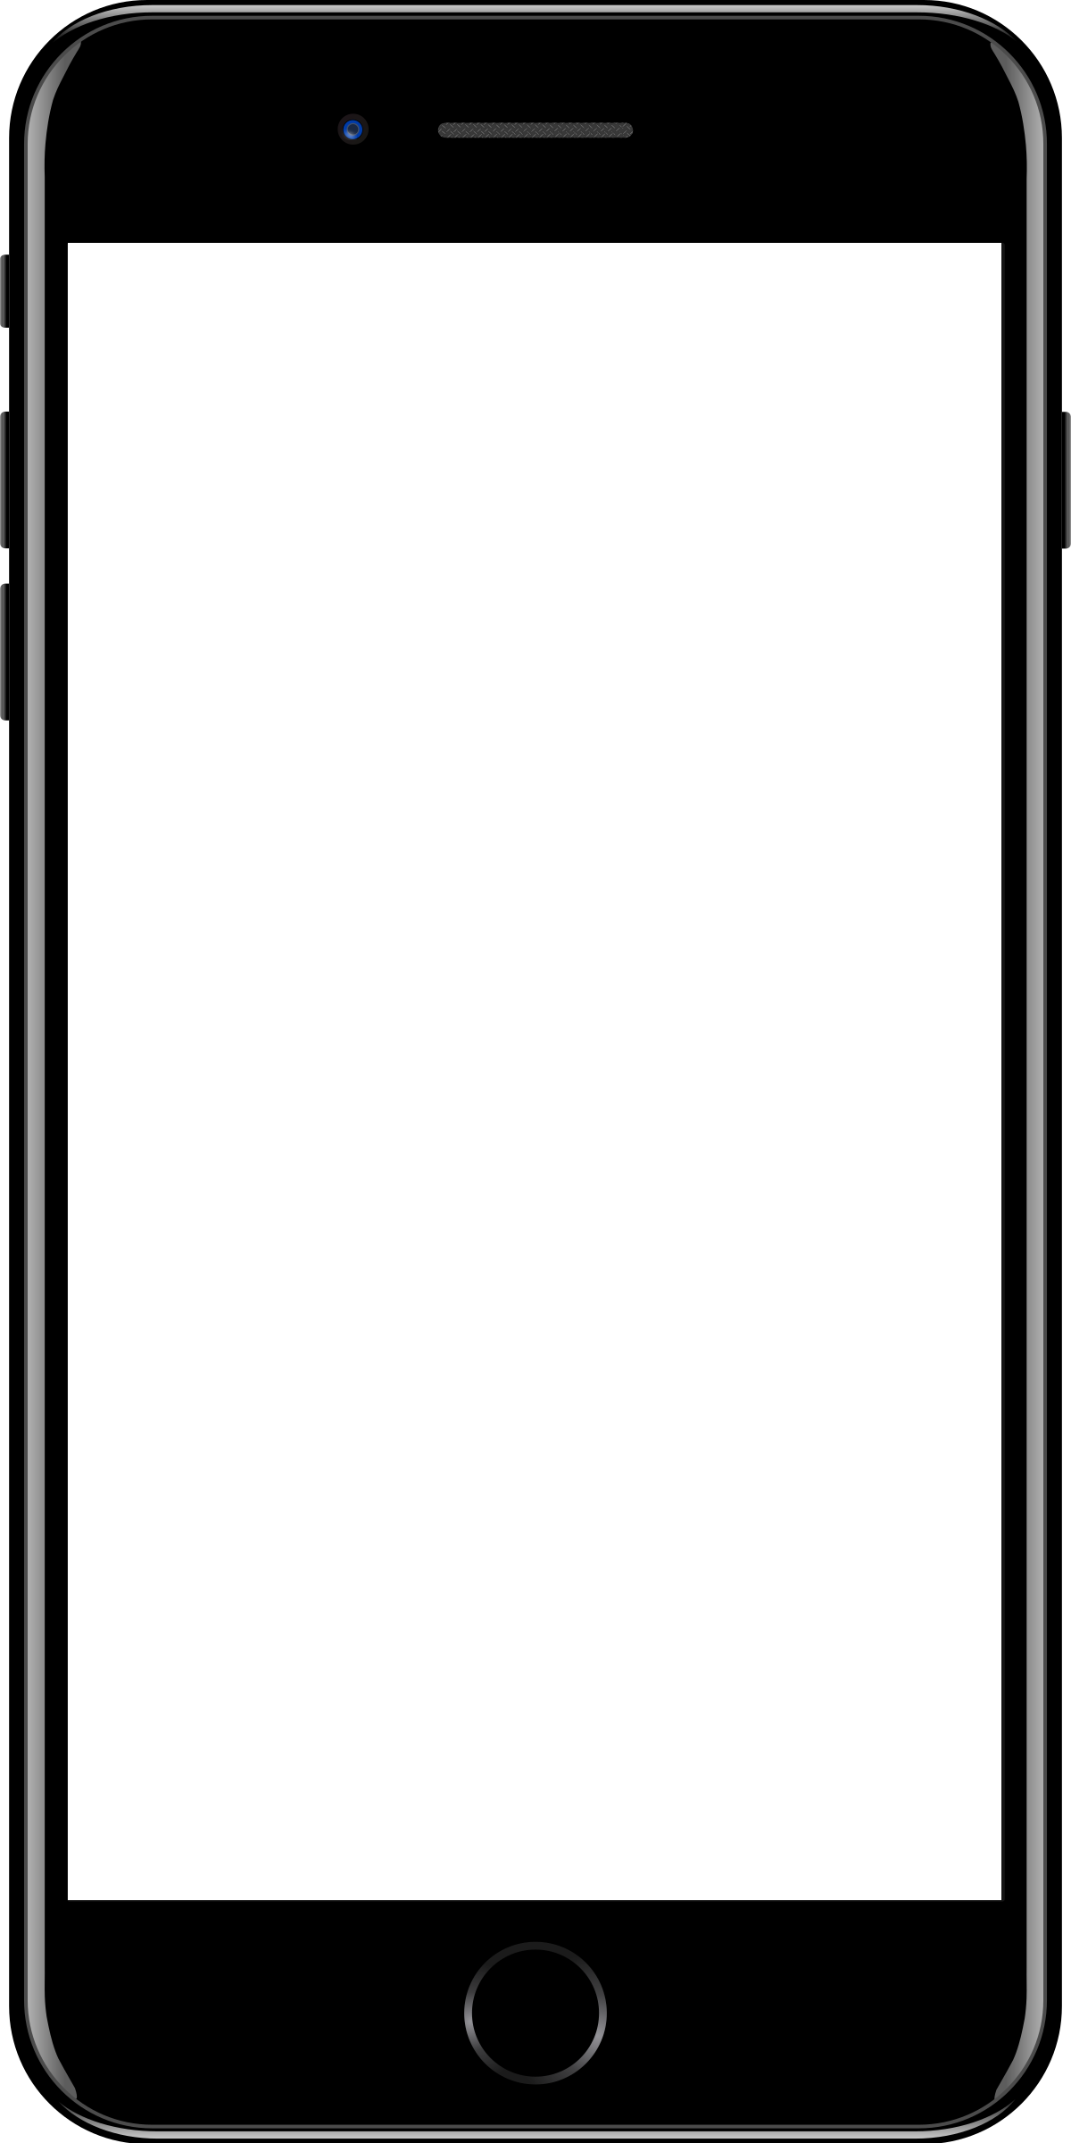
Sample mobile app slide
iPhone 7/8
iPhone 14
Generic phone
(BrandCentral)
App screenshots can be placed behind these transparent .pngs

Slide 4
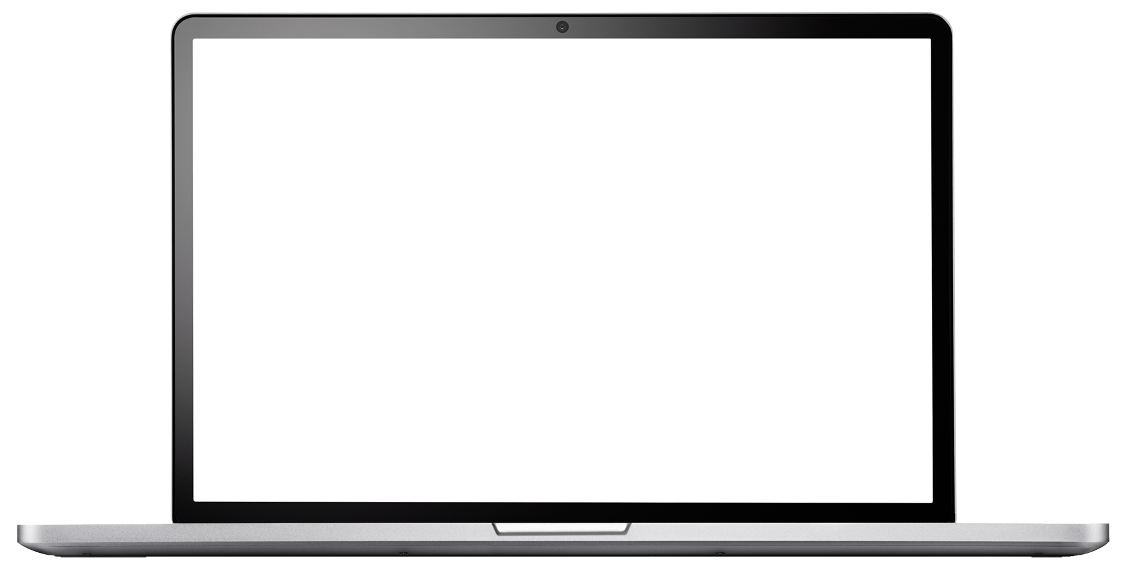
Sample website slide (blank)
Website screenshots can be placed behind this transparent .png

Slide 5
Bullet points layout with subtitle Subtitle is smaller in the same text block
Example of a bulleted slide with a subhead
Set the slide title to “Sentence case”
Set subheads to “Sentence case”
Hyperlink style
www.microsoft.com

